Slide 1
Molecular genetic in lymphoma
Dr.Amir Vahedi
Professor of Pathology, Tabriz Medical Sciences
Fellowship of Molecular Pathology and Cytogenetic

Slide 2
Lymphoma Classification

Slide 3
Lymphoma Classification

Slide 4
Lymphoma Classification

Slide 8
Molecular tests in lymphoma
Molecular diagnostic methods can provide an additional level of testing for definite diagnoses
Prognostic information
Provide targets for therapy
For monitoring the disease(MRD)

Slide 9
Topics
Clonality tests
Double/tripe hit lymphoma (MYC/BCL2, MYC/BCL6, MYC/BCL2/BLC6) in DLBCL
GCB/ABC type gene expression profiles and IRF4 rearrangements
Translocations:
t(8;14)(q24;q32)/MYC-IGH
t(14;18)(q32;q21) IGH-BCL2
t(2;5) ALK-NPM
t(11;18)

Slide 10
Clonality
Mature B- and T- cells both have immunological receptors on the cell surface
In B-cells, cell surface immunoglobulins (Ig) consist of a heavy chain and a light chain, which are encoded by heavy chain (IGH), and light chain genes: IGK for kappa light chains and IGL for lambda light chains
Only one of the two types of light chain gene is expressed and included in the final Ig receptor in each B-cell
In T-cells, the immunological receptors are dimers, encoded by T-cell receptor (TCR) genes: TCRA and TCRB, or TCRD and TCRG, which produce ‘alpha-beta’ or ‘delta-gamma’ T-cell receptors respectively

Slide 11
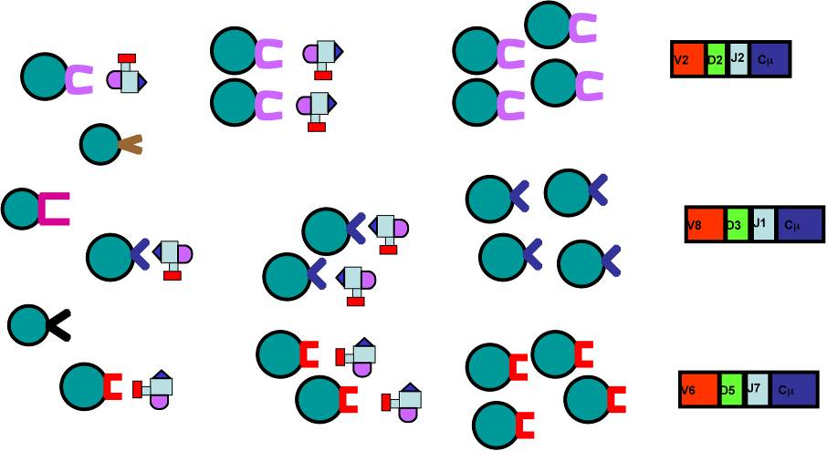
A reactive lymphocyte proliferation is polyclonal;
Each expanded clone has different gene re-arrangement

Slide 12
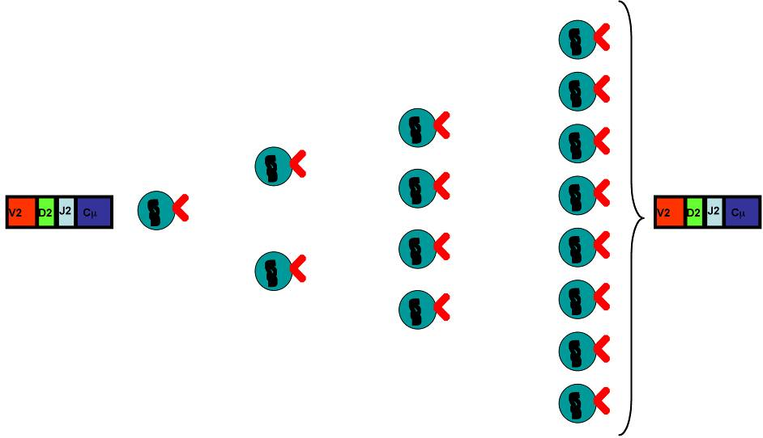
A neoplastic lymphocyte proliferation is clonal
Same gene rearrangement
Same chromosomal abnormality

Slide 13
During Bcell differentiation, first the IGH genes rearrange, then IGK, potentially resulting in IgH/k expression or followed by IGK deletion and IGL rearrangement, potentially followed by IgH/l expression
During T-cell differentiation, first the TCRD genes rearrange, then TCRG,potentially resulting in TCRgðexpression or followed by further TCRB rearrangement and TCRD deletion with subsequent TCRA rearrangement, potentially followed by TCRab expression

Slide 14
Application
Any suspect B-cell proliferation when morphology and immunophenotyping are not conclusive
All suspect T-cell proliferations (caution: T-cell-rich B-NHL)
lymphoproliferations in immunodeficient patients, including post-transplant patients
Evaluation of the clonal relationship between two lymphoid malignancies in one patient or discrimination between a relapse and a second malignancy
further classification of a malignancy, for example, via Ig/TCR gene rearrangement patterns or particular chromosome aberrations
occasionally, staging of lymphomas

Slide 15
targets
IGH VH–JH
IGH DH–JH
IGK
IGL
TCRB
TCRG
TCRD

Slide 16
PCR analysis
Distance between the primers should be less than 1 kb, preferably less than 500 bp,and in formalin-fixed tissues preferably less than 300 bp
Advantages of PCR:speed, the low amounts of DNA required, the possibility to use DNA of lower quality, and the relatively good sensitivity of 1–5%, for some types of rearrangements even <1%,suitable for FNA and parafin fixed samples

Slide 17
Limitations and pitfalls of molecular clonality studies
Limited sensitivity:in the detection of small clonal cell populations with less than 5–10% clonal lymphoid cells
Clonality is not equivalent to malignancy:CD8+ lymphocytosis,benign monoclonal gammopathy,EBV+ lymphoproliferation,benign cutaneous T cell proliferation(lymphomatoid papulosis).
Results of molecular clonality studies should always be interpreted in the context of the clinical, morphological, and immunophenotypic diagnosis

Slide 18
Ig and TCR gene rearrangements are not markers for lineage:Crosslineage TCR gene rearrangements occur relatively frequently in immature B-cell malignancies, particularly in precursor B-ALL (>90% of cases), Crosslineage Ig gene rearrangements, mainly involving the IGH locus, also occur in T-cell malignancies and AML.
Virtually all (>98%) TCRab‏ T-cell malignancies have TCRG gene rearrangements (generally biallelic) and many TCRgd‏ Tcell malignancies have TCRB gene rearrangements, implying that the detection of TCRB or TCRG rearrangements is not indicative of T cells of the ab or gd T-cell lineage
Unusual Ig/TCR gene rearrangement patterns:precursor B-ALL and T-ALL

Slide 19
False-positive results:single-strand conformation polymorphism analysis, denaturing gradient gel electrophoresis, heteroduplex analysis, or GeneScanning
False-negative results :due to improper annealing and somatic hypermutation in rearrengement genes .
particularly in Ig/TCR genes with many different gene segments. In TCRG and TCRD genes this problem is minimal, because of the limited number of different gene segments

Slide 20
Heteroduplex analysis of PCR products:
Denatured at high temperature (95C for 5 min), followed by rapid random renaturation at low temperature (preferably at 4C for 1 h)
This enforced duplex formation results in many different heteroduplexes in polyclonal lymphoproliferations, but results in homoduplexes in monoclonal lymphoproliferations
Electrophoresis of the homoduplexes in a 6% polyacrylamide gel results in a single band within a predictable size range, whereas the heteroduplexes form a smear at a higher position

Slide 22
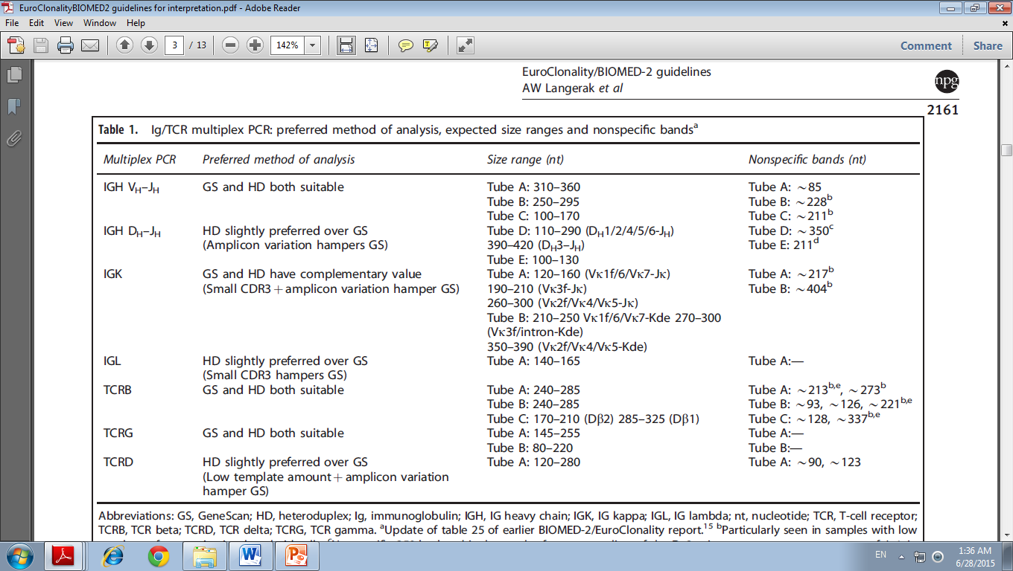

Slide 24
New in 2016 WHO
According to the 2016 WHO classification, the diagnosis of DLBCL, NOS, should include cell of origin (COO); germinal centre B-cell (GCB) or activated B-cell (ABC)/non-GCB subtypes, because of their different molecular features, biologic behavior, prognosis and treatment.
High-grade B-cell lymphoma (HGBL) with MYC and BCL2 and/or BCL6 rearrangements (i.e., double-hit or triple-hit lymphoma, DHL or THL) as well as HGBL, NOS, are two new categories in the 2016 revised WHO classification that substituted the provisional category of B-cell lymphoma, unclassifiable (BCLU) with features intermediate between DLBCL and Burkitt lymphoma (BL), which was introduced in the 2008 WHO classification
New provisional entity called Burkitt-like lymphoma with 11q aberration

Slide 25
DLBCL, NOS
Morphological variants:
Centroblastic
Immunoblastic
Anaplastic
Specific immunophenotype
Double-expresser DLBCL, NOS
CD30-positive DLBCL, NOS
CD5-positive DLBCL, NOS
Cyclin D1-positive DLBCL, NOS
Molecular subtypes
Germinal centre B-cell (GCB) subtype
Activated B-cell (ABC) subtype
Unclassified by gene expression profiling

Slide 26
Primary DLBCL of the CNS
Primary cutaneous DLBCL, leg type
Primary mediastinal (thymic) large B-cell lymphoma (PMBL)
Primary effusion lymphoma (PEL)
Intravascular large B-cell lymphoma
T-cell/histiocyte-rich large B-cell lymphoma (THRLBCL)
Plasmablastic lymphoma (PBL)
EBV-positive DLBCL, NOS
HHV8-positive DLBCL, NOS*
DLBCL associated with chronic inflammation
Lymphomatoid granulomatosis
ALK-positive large B-cell lymphoma
Large B-cell lymphoma with IRF4 rearrangement
Burkitt lymphoma
Burkitt-like lymphoma with 11q aberration*
HGBL with MYC and BCL2 and/or BCL6 rearrangement (i.e., double-hit or triple-hit lymphoma)
HGBL, NOS
B-cell lymphoma, unclassifiable, with features intermediate between DLBCL and CHL

Slide 27
DLBCL,NOS (GCB vs ABC type)
Germinal center B cell-like (GCB)-DLBCL exhibits a transcriptional profile that resembles that of a GCB cell with expression of CD10 and the transcriptional repressor BCL6 and harbouring highly mutated immunoglobulin genes with ongoing somatic hypermutations (SHM)(BCL2 rearrangement and recurrent mutation of BCL2, TNFRSF14 , EZH2 , and GNA13 )
Activated B cell-like (ABC)-DLBCL shows several features of B cell receptor (BCR) activated B-cells with upregulation of genes required for plasma cell differentiation (IRF4/MUM1):NF-kB activation and recurrent mutation of MYD88 and CD79B
ABC subtype has worse prognosis than GCB subtype with R-CHOP therapy
Primary DLBCL of the CNS , testis , and breast , as well as primary cutaneous DLBCL, leg type usually belong to ABC subtype

Slide 29
IHC in typing
The Hans algorithm has been the most widely used in clinical trials. In this classifier three antibodies are used CD10, BCL6 and IRF4/MUM1 . Cases positive for CD10 or cases positive for BCL6 and negative for IRF4/MUM1 are classified as GCB phenotype whereas cases that are IRF4/MUM1 positive with or without expression of BCL6 are assigned to the non-GCB subtype

Slide 31
CD30 in DLBCL
CD30 is positive in 10–20% of cases of DLBCL, NOS and might be associated with anaplastic morphology .
Interestingly, the GEP of CD30+ DLBCL overlaps with that of PMBL, and is associated with a favorable prognosis with R-CHOP (rituximab, cyclophosphamide, doxorubicin, vincristine, and prednisolone) therapy.
Some recent studies showed that CD30 expression in DLBCL was associated with lack of MYC rearrangement, which might be the real cause of its better prognosis .
Cases with CD30 expression might benefit from anti-CD30 therapy

Slide 32
CD30 in DLBCL(anaplastic variant)

Slide 33
CD5 in DLBCL
CD5 is positive in about 5–10% of cases of DLBCL
The minority of CD5- positive DLBCL cases are transformed from B-chronic lymphocytic leukemia/small lymphocytic lymphoma (so-called Richter transformation).
CD5 positivity is associated with higher frequency of bone marrow involvement, CNS relapse, ABC subtype, BCL2 overexpression, STAT3 and NF-kB activation, and worse overall survival in cases of DLBCL, NOS with R-CHOP or R-EPOCH (rituximab, etoposide, prednisone, vincristine, cyclophosphamide and doxorubicin) treatment

Slide 34
Cyclin D1 in DLBCL
Cyclin D1 expression has been reported in 1.5–15% of DLBCL cases with about 10% of these cases showing copy number gains of CCND1 gene, but not translocation .
Cyclin D1-positive DLBCL, NOS, can be distinguished from pleomorphic mantle cell lymphoma (MCL) by lack of CD5 and SOX11 expression and lack of CCND1 translocation

Slide 35
Cyclin D1 positive DLBCL(DD: MCL,blastic variant)

Slide 36
Double-expresser lymphoma
A subset of DLBCL, NOS show co-expression of MYC and BCL2 proteins, without demonstrable MYC or BCL2 translocation
BCL2 and MYC protein are positive in about 50% and 30%, respectively
Double expresser lymphomas account for about 30% of DLBCL, NOS, and they are more commonly of the ABC subtype
Double-expresser lymphomas are associated with worse prognosis when compared with cases that do not express MYC and BCL2 proteins, but better prognosis when compared to DH or TH lymphomas

Slide 37
MYC rearrangement (single-hit lymphoma)
Landsburg et al. found that cases of single hit DLBCL, NOS with R-CHOP treatment showed poor prognosis similar to DHL, but those with more intensive therapy revealed better prognosis similar to MYC-normal DLBCL, NOS
The poor prognosis is probably due to p53 mutations, and they suggested SHL be treated as DHL

Slide 38
Burkitt lymphoma
BL is a highly aggressive but potentially curable mature B-cell lymphoma, characterized by MYC translocation to an IG locus, and simple karyotype.
BL is considered to arise from GC B-cells in the dark zone and expresses CD10 and BCL6, but not BCL2.
A combination of morphology, immunophenotyping and genetic analysis is necessary for the diagnosis of BL

Slide 39
BL Ki-67:100%

Slide 40
BCL6 and BCL2 in BL

Slide 41
Myc IHC and FISH(break apart probe) in BL

Slide 42
Molecular features and FISH analysis in BL
The molecular feature of BL is MYC rearrangement with the partner mostly IGH as t(8;14)(q24;q32) and less commonly IGK as t(2;8)(p12;q24) or IGL as t(8;22)(q24;22q11).
MYC rearrangement also occurs in other types of lymphoma, including plasmablastic lymphoma, HGBL, and DLBCL, NOS, as well as rare cases of transformed lymphomas .
In contrast to other lymphomas with MYC rearrangement, BL cases show relatively simple karyotype with no or very few chromosomal aberrations except MYC rearrangement

Slide 43
FISH for MYC
FISH is a sensitive and specific method to detect MYC rearrangement. Around 3–10% of BL cases lack MYC rearrangement detected by FISH or conventional cytogenetics .
A distant breakpoint from MYC gene or small insertion of MYC into IG locus is suggested in some negative cases that may be detected by specifically designed FISH probes .
It is recommended to use several FISH probes both break-apart probes (BAP) and dual-fusion probes (DFP) in cases where BL is suspected and the initial FISH analysis is negative

Slide 44
Break-apart versus DFP

Slide 45
Mutational landscape in BL
Mutations in TCF3 and/or its negative regulator ID3 are identified in 70%, 67%, and 40% of sporadic BL, HIV associated BL, and endemic BL, respectively, but rare in other lymphomas, such as DLBCL
In contrast, other recurrent mutations of DLBCL, such as EZH2, SGK1, BCL2, CD79B, and MYD88, are rarely found in BL

Slide 46
Burkitt-like lymphoma with 11q aberration
Recently, some cases resembling BL in morphology, immunophenotype, and gene expression profile, but also DLBCL, NOS, lack MYC rearrangement and contain a peculiar chromosome 11q aberration with gain in 11q23.2- 23.3 and loss of 11q24.1-qter .
These cases have more complex karyotypes and more frequent nodal presentation than BL, but the clinical course and prognosis seem to be similar

Slide 48
HGBL with MYC and BCL2 and/or BCL6 rearrangements
(so-called DHL or THL) is defined as an aggressive mature B-cell lymphoma with coexisting rearrangements of MYC at chromosome 8q24 and BCL2 at chromosome 18q21 and/ or BCL6 at chromosome 3q27
Cases with rearrangements of all three loci, MYC, BCL2 and BCL6, are called THL.
Cases with coexisting rearrangements of BCL2 and BCL6 without MYC rearrangement, and cases with coexisting rearrangements of MYC and other genes such as CCND1 are excluded
MCL with MYC rearrangement (84,85), are excluded too
Cases with amplification, copy number gains, somatic mutation of genes or increased protein expression, including double-expresser DLBCL, without translocation are excluded

Slide 49
transformed FL with DLBCL component showing MYC and BCL2 rearrangements should be diagnosed as HGBL with MYC and BCL2 rearrangements, transformed from FL
Cases of MYC-BCL6 DHL and THL are much less common than MYC-BCL2 DHL
Around 33–85% of MYC-BCL6 DHL show DLBCL morphology, while 15–67% of cases display BCLU morphology.
Half of THL reveal DLBCL morphology and the other half show BCLU morphology in one series

Slide 50
Myc and BCL6 rearrangement (Break apart probe)

Slide 52
MYC-BCL2 DH lymphomas are mostly GCB phenotype , and almost all these cases express BCL2 , in contrast to BL.
BCL2-rearranged cases are negative for BCL2 (clone 100D5) due to BCL2 missense mutations, but stain for the BCL2, E17 clone
Compared with MYC-BCL2 DHL, cases of MYC-BCL6 DHL express less CD10 (50–75%) and BCL2 (17–80%), but more IRF4/MUM1 (17–88%)
Around 75–86% of MYC-BCL6 DHL cases display GCB phenotype and only 17–33% of cases show double expression of MYC and BCL2, which are less than MYC-BCL2 DHLs

Slide 53
There is a pitfall to misdiagnose MYC-BCL6 DHL cases as BL due to overlapping morphology, common GCB phenotype and BCL2 negativity.
The clinical presentation in younger patients, monotonous neoplastic cells without prominent nucleoli, and simple karyotype are clues for BL diagnosis
THL reveal similar immunophenotype than that of DHL with MYC-BCL2

Slide 54
Although MYC and BCL2 protein expression correlate with gene translocation in the majority of cases, still around 25% of DHL are negative for MYC using the 40% cut-off value and do not show double expression of MYC and BCL2 .
The percentage of non-double expression is even lower in MYC-BCL6 DHL .
Therefore, it is believed that a good percentage of DHL are missed by immunohistochemistry

Slide 55
When use FISH
Some studies suggest performing FISH analysis in all newly-diagnosed cases of DLBCL
start with MYC FISH in cases with aggressive clinical presentation, blastoid or BCLU morphology, double expression of MYC and BCL2, as well as GCB phenotype, and then perform BCL2 and BCL6 if MYC is found to be rearranged.

Slide 56
Break-apart versus DFP
To detect MYC translocation, BAP for MYC gene or DFP of IGH-MYC can be used. BAP shows higher sensitivity than DFP, because of its detection of both IG and non-IG partner, easier interpretation, and probe-design. However, BAP still can result in false negative cases, depending on the probe design and breakpoints
DFP helps identifying the translocation partner of MYC and detect some false-negative cases by BAP .
Two-probe approach is optimal, and we suggest at least to start with a BAP due to its higher sensitivity and easier interpretation

Slide 57
MYC translocation partner: IGH, IG light chain or non IG gene
The partners of MYC translocation are IG gene in around two-thirds of the cases while non-IG partners are identified in one-third
Although both IG and non-IG partner fulfill diagnosis of DHL or THL in the 2016 revised WHO classification, some studies showed worse prognosis in cases with IGMYC translocation than non-IG-MYC translocation with R-CHOP treatment

Slide 58
HGBL, NOS
HGBL, NOS is defined as aggressive B-cell lymphoma that lacks MYC, BCL2 and BCL6 rearrangements and morphologically does not fall into the categories of DLBCL, NOS or BL
This new provisional category includes cases of BCLU or blastoid morphology without DH or TH.
DLBCL, NOS with single hit of MYC or BL with slightly atypical morphology or immunophenotype are excluded.
Burkitt-like lymphoma with 11q aberration is also excluded from HGBL, NOS.

Slide 59
Detecting chromosomal translocations in NHL
by traditional cytogenetic methods as well as by molecular genetic methods that include Southern transfer, PCR, and fluorescence in situ hybridization (FISH).
Because the demonstration of cytogenetic abnormalities in lymphoid neoplasms with traditional cytogenetic methods is technically difficult, especially in low grade neoplasms that are associated with a low mitotic rate, molecular approaches are preferred

Slide 61
t(11;14) with BCL1-IGH rearrangement
The t(11;14)(q13;q32) is characteristic for MCL because this cytogenetic reciprocal translocation was observed in 60–70% of MCL cases and only sporadically in other B-cell NHL
The gold standard detection strategy for the presence of the t(11;14) that will identify almost all breakpoints is interphase FISH using breakpoint-flanking probes in fresh or frozen material140 as well as in archival specimens
However, a PCR-based detection strategy for the t(11;14) might be useful for residual disease monitoring using a consensus JH primer in combination with primers in the BCL1-MTC region that were all located in a region of 392 bp.

Slide 63
A. Normal lymphoid nuclei, B. Mantle cell lymphoma t(11;14)

Slide 64
t(14;18) with BCL2-IGH rearrangement
It is detectable in up to 90% of FCLs and 20% of large-cell B-cell lymphomas depending upon the diagnostic test used
For molecular diagnostic laboratories PCR-based detection strategies offer rapid results, are generally applicable, and can be used for residual disease monitoring. PCR-based techniques only detect up to 60% of translocations,which seriously impairs the diagnostic capability of PCR
We initially evaluated a two-tube multiplex system, one tube designed to detect breakpoints within the MBR and a second tube used to identify breakpoints outside this region. The MBR
strategy contained three primers MBR1, MBR2, and the consensus JH primer. The second multiplex reaction contained five primers, MCR1, MCR2, 50mcr, 30MBR1, and the consensus JH and was designed to detect breakpoints within the mcr, 50mcr, and 30MBR regions.

